Slide 1
SC-1015 Mini Project
Does Weather cause Traffic Accidents?
By SC18/Grp 7:
Vernon, Jing Kai, Jarrel
Notes:
Dear friends, welcome and thank you for listening to our presentation. Today I will be presenting to you, on our group’s mini project for SC-1015 investigating the possibility of weather affecting the rate of traffic accidents occurring. Our group consists of Vernon, Jing Kai and myself Jarrel.

Slide 2
Table of Contents
01
02
03
04
Objectives
(Overview)
Our Dataset
(Data representation and more)
Our Analysis and Predictions
(What we found out)
Our Conclusion
(The end)
Notes:
Here is a brief outline of our project

Slide 3
Our Motivation
==
/*Objective in mind*/
Notes:
Now let’s first start with our motivation for the project, everyone knows that extreme weather can lead to congestion, heavy traffic and poor road condition, but can it be extreme enough to result into an accident?

Slide 4
Is weather is a contributing factor to traffic accidents in the US?
Our problem statement == (Issue at hand)
Notes:
We sought out to investigate if weather was a significant factor in causing traffic accidents, based on data sets on the US we sourced from kaggle.

Slide 5

Let’s think about it.
Notes:
Now let’s take a moment to think,(click)
At first glance, it would be a fair assumption to think that poor weather conditions would arise to an increased rate of accidents. But let’s see if our analysis reaffirms this notion.

Slide 6
Breaking it down
==
(Our step by step process)
Data
Analysis
Prediction
Use model to predict if the weather has any correlation with traffic accidents
Clean Dataset to find variables pertaining to weather
Find and use the best regression model to distribute the data
Notes:
So here we took a step by step approach of cleaning the weather data to source the important variables, analysed the data using a regression model, and finally used the model to investigate if there was correlation between the severity of weather and the rate of traffic accidents.

Slide 7
Our Dataset
==
/*Variables Used*/
Notes:
First off let’s take a look at the dataset we sourced.

Slide 8

Our source== ( Where we got the data from)
Notes:
We found the dataset on kaggle, with weather data spanning 49 states of the United States of America, recorded from 2016 to 2021. We have linked the reference to our dataset in our references page as well as our github repository.

Slide 9





(Weather Distribution) == (Cities we chosen)
New York
Denver
01
02
Minneapolis
03
Miami
Phoenix
04
05
Notes:
We picked five cities from across America based on geographical spread, those being: New York, Denver, Minneapolis, Miami and Phoenix. For a simpler representation and to remove bias across all cities, we have concatenated these cities into a single set.
We concatenated the data into a single set to get an overview for the findings for our analysis

Slide 10
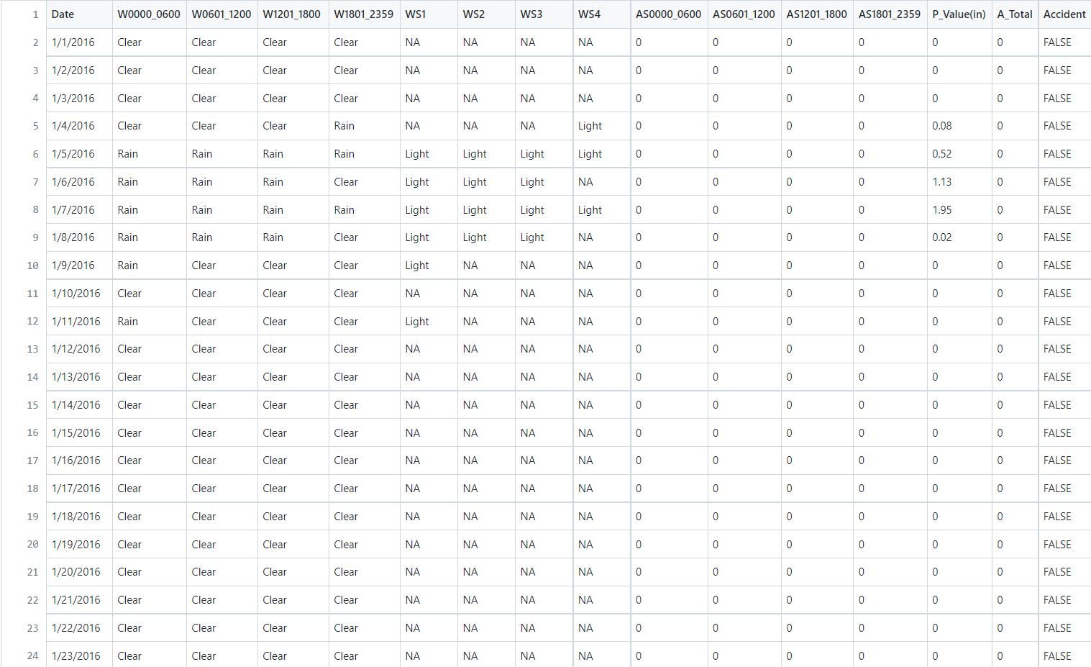
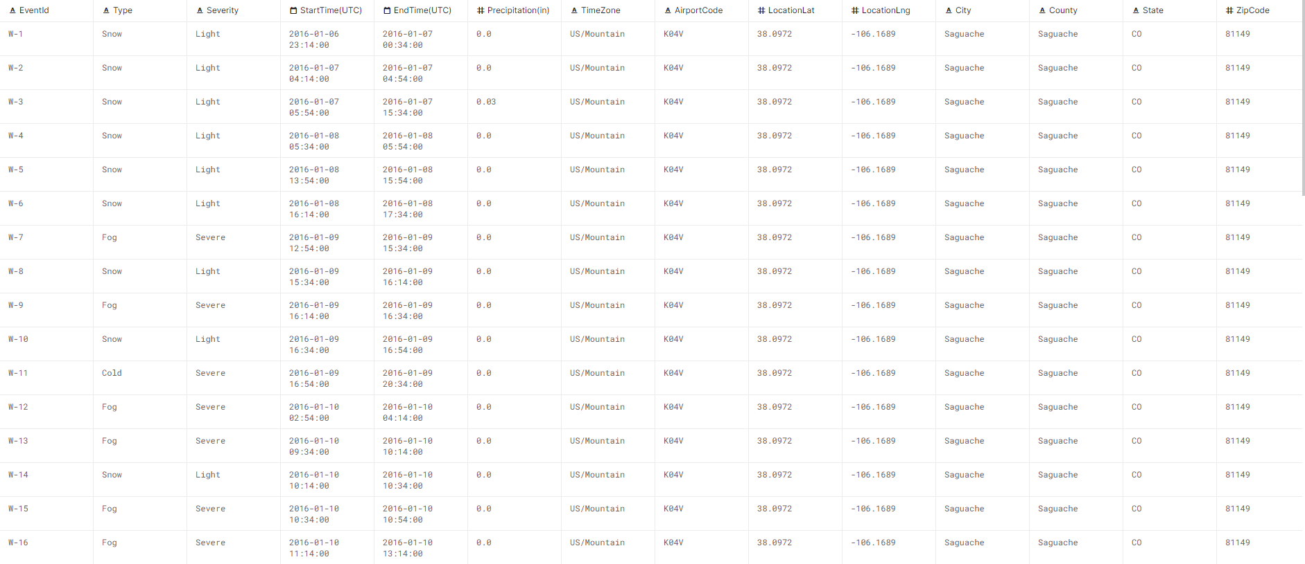
Cleaned Dataset != (Unnecessary Details)
Notes:
We cleaned the data by extracting the values we required, such as precipitation and weather type, as we did not require unnecessary details such as latitude, longitude or zip codes. For comparison here is the original data set (click)
and here is our cleaned dataset. We used C++ to clean the data set which originally was 5 GB in size as while Importing a 5 GB CSV is convenient using python, it would take up a lot of RAM. And since our data is extracted city by city we decided it would be easier to use C++ to speed up the data cleaning process.

Slide 11
Our Analysis
==
/*What we found out*/
Notes:
Now let’s take a look at our in depth analysis.

Slide 12
Variables
==
(Will it cause traffic accidents?)
Precipitation
Weather Type
Weather Severity
Does the precipitation level have anything to do with accident count?
Or is it the type of weather that affects it?
Perhaps it’s the severity of weather?
Notes:
These are the variables we tested to see if they can predict traffic accidents. We have precipitation level, the type of weather and the severity of weather.

Slide 13
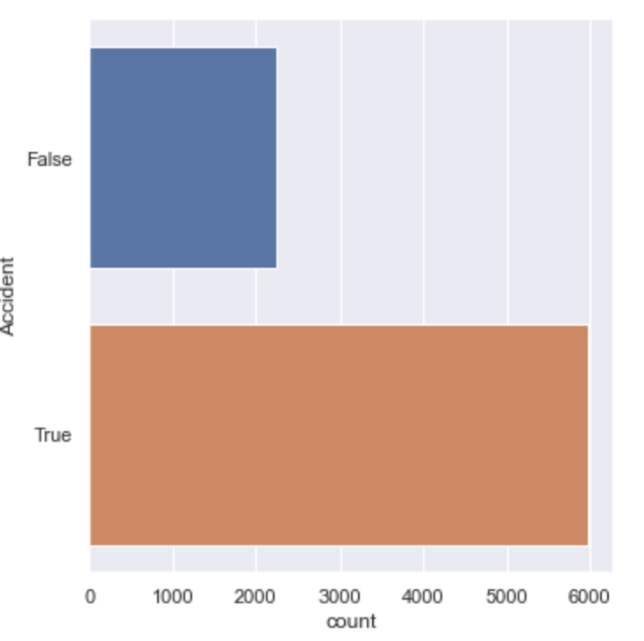
Analysis == (Looking Deeper)
Notes:
Here is an exploration of the count of accidents in the 5 cities over the span of 6 years. From the bar chart, we can see that the accident count is much higher than its negation. This information will subsequently be used in our classification tree model.

Slide 14
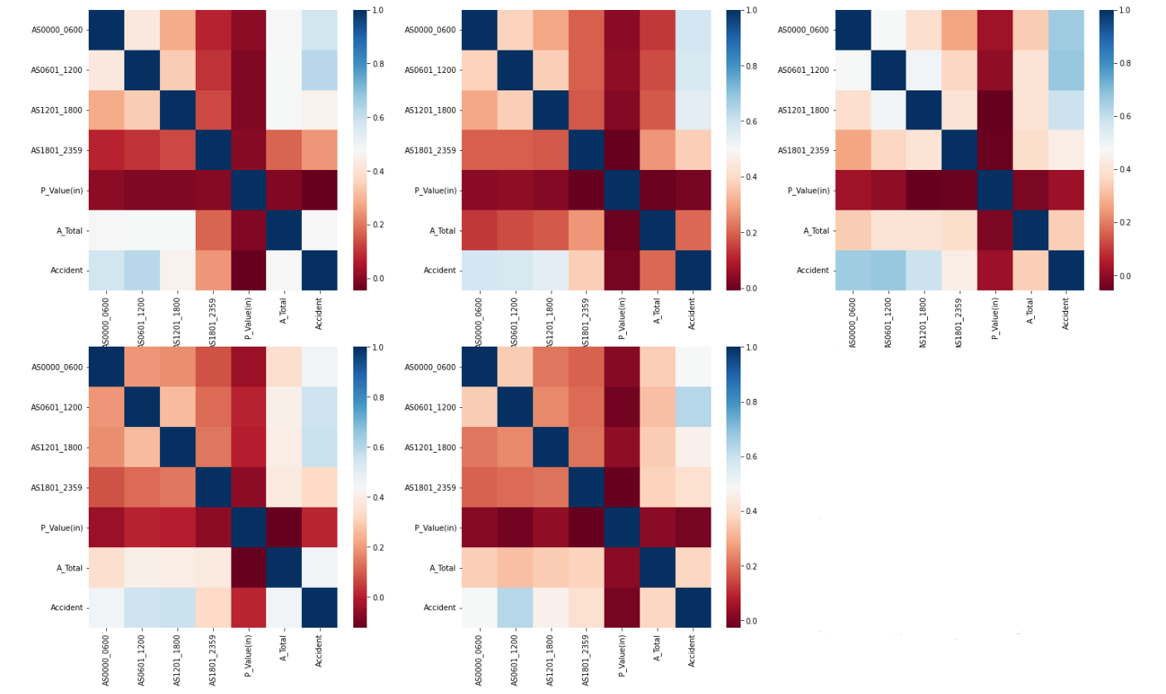
Analysis == (Looking Deeper)
Precipitation
Notes:
Now let’s see if precipitation correlates to traffic accidents. Using a heat map to visualise our findings we can observe that there is apparently no relationship between precipitation level and accident count. /*Do we want to concat this too?*/

Slide 15
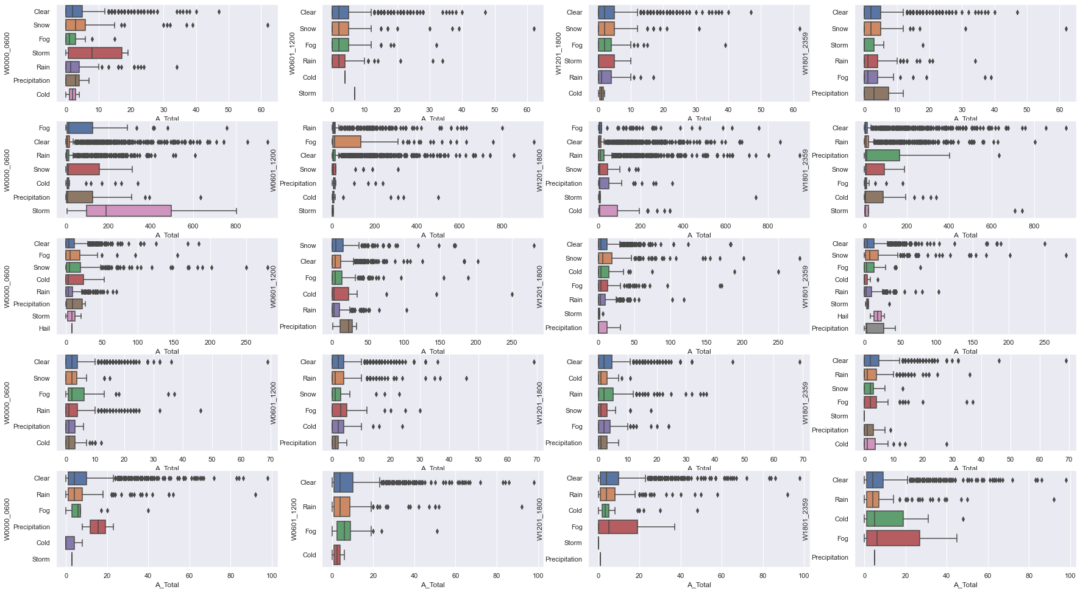
Analysis == (Even Deeper)
Weather Type
Denver
Miami
Minneapolis
New York
Phoenix
Notes:
Next let’s analyse the correlation between the type of weather and traffic accidents. By looking at the box plots, it gives an easy overview of what happened in different cities. As you might have noticed, (1st & 2nd row 1st column) Storm weather seems to be causing the most accidents In Miami and Denver (Same goes for Phoenix, Cold and Fog). However, it might not be wise to conclude that the weather is causing more accidents just by looking at these plots, as this particular trend cannot be observed in every single plot.
By using a boxplot easily to visualise the data we can find the correlation between this categorical data and the frequency of traffic accidents in each type of weather condition. As you can see it varies from city to city. /*Do we want to concat this too?*/

Slide 16
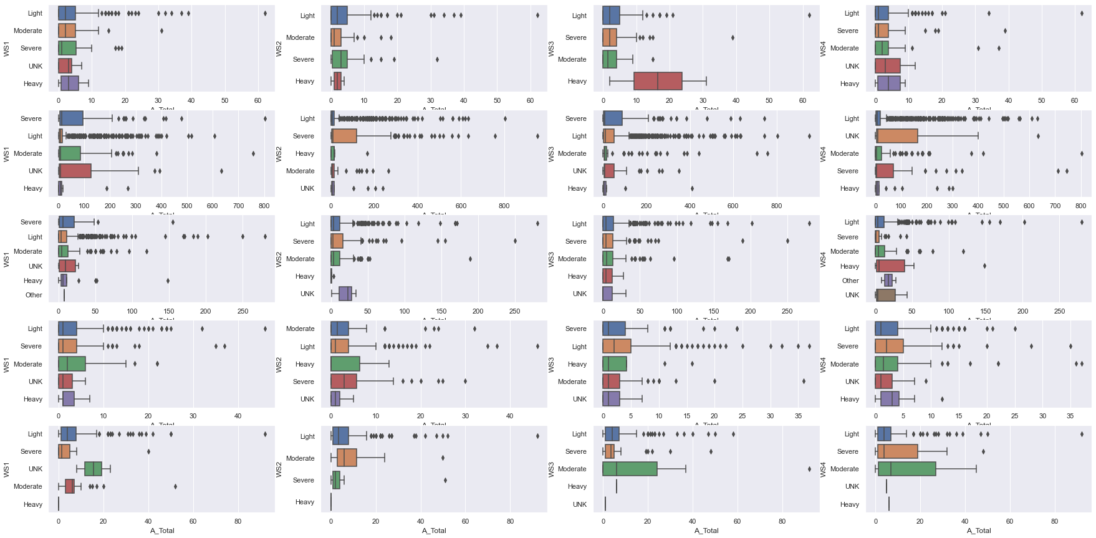
Analysis == (Even Even Deeper)
Weather Severity
Denver
Miami
Minneapolis
New York
Phoenix
Notes:
Finally let’s look at the correlation between the severity of weather and traffic accidents. The data also varies much from city to city similar to the weather type data before it. /*Do we want to concat this too?*/

Slide 17
Our Predictions
+=
/*Can we see the future?*/
Notes:
Now moving on, we have our prediction models.

Slide 18
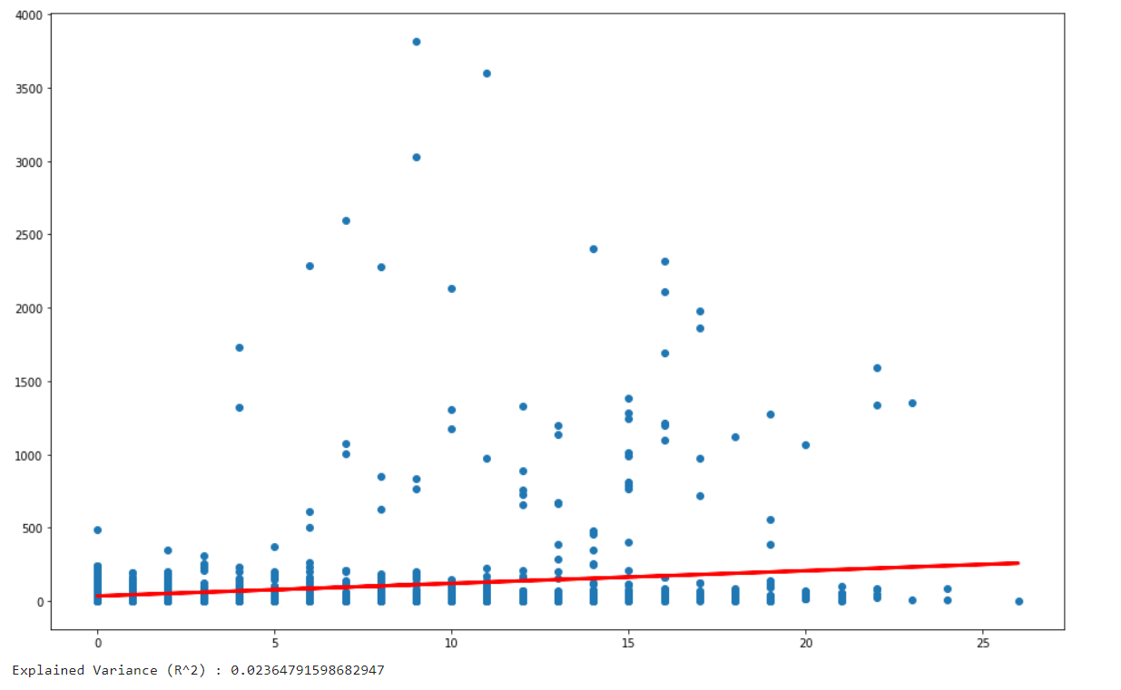
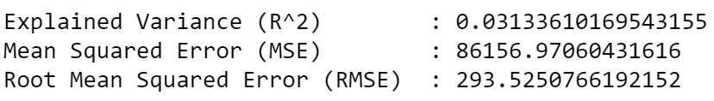
Our Prediction Model == (Can we see the future?)
Linear Regression Model
|VERY BAD|
(Do not try this at home)
Notes:
Here you can see we attempted to use the linear regression model to predict the total number of accidents. (click)
However as we have discovered it is very bad for predicting the total number of accidents, (click)
as the R^2 value is at a mere 2% and the Root Mean Squared Error is at a significant value of 293.

Slide 19
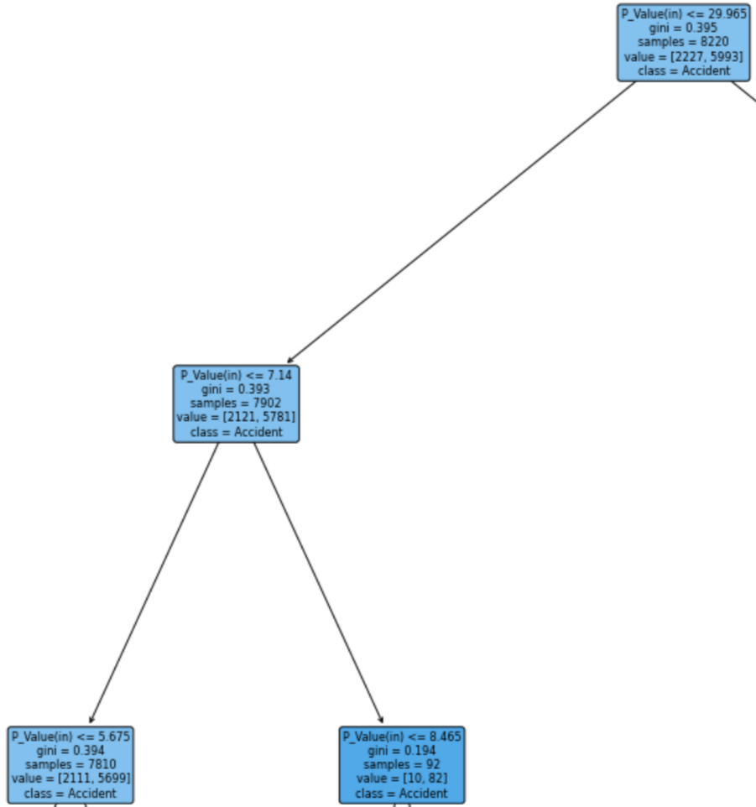
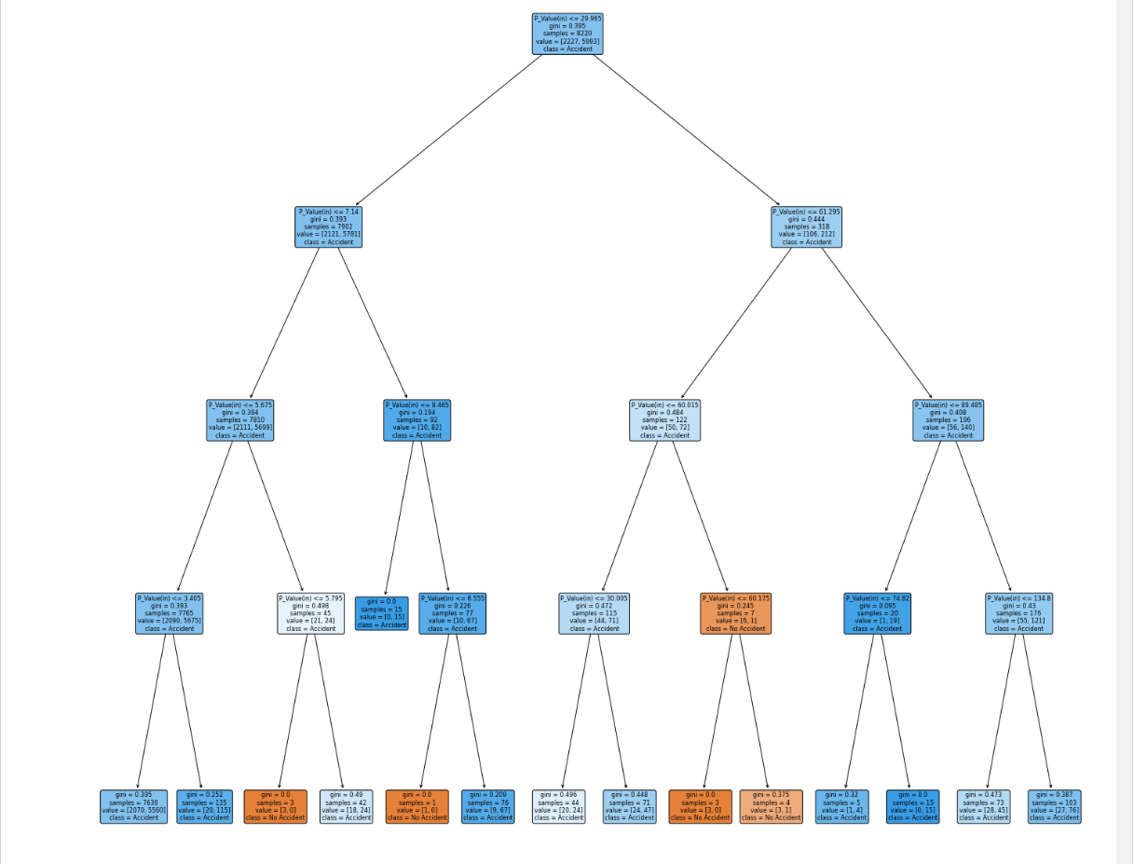
Our Prediction Model == (Can we see the future?)
Classification Tree Model
Notes:
After the linear regression we tried other methods, this time using the classification tree method to see if weather correlates to traffic accidents. (click)
In this model we used the precipitation value to predict whether an accident would occur at that range of precipitation.

Slide 20
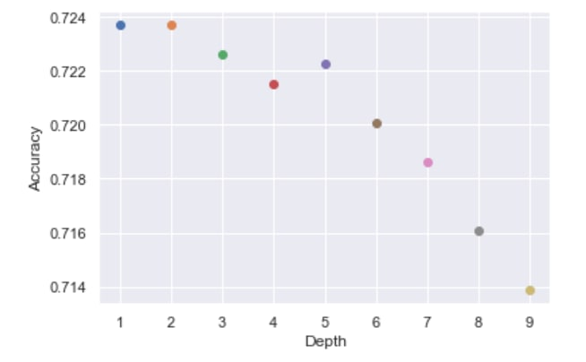
Our Prediction Model == (Can we see the future?)
Notes:
To further increase accuracy, we have looked for ways to obtain a much more accurate decision tree. One way we found, is to tune the max depth of the tree to increase its accuracy,(click)
in this scenario we have observed that a max_depth of 1 or 2 is much more accurate then the other depths.

Slide 21
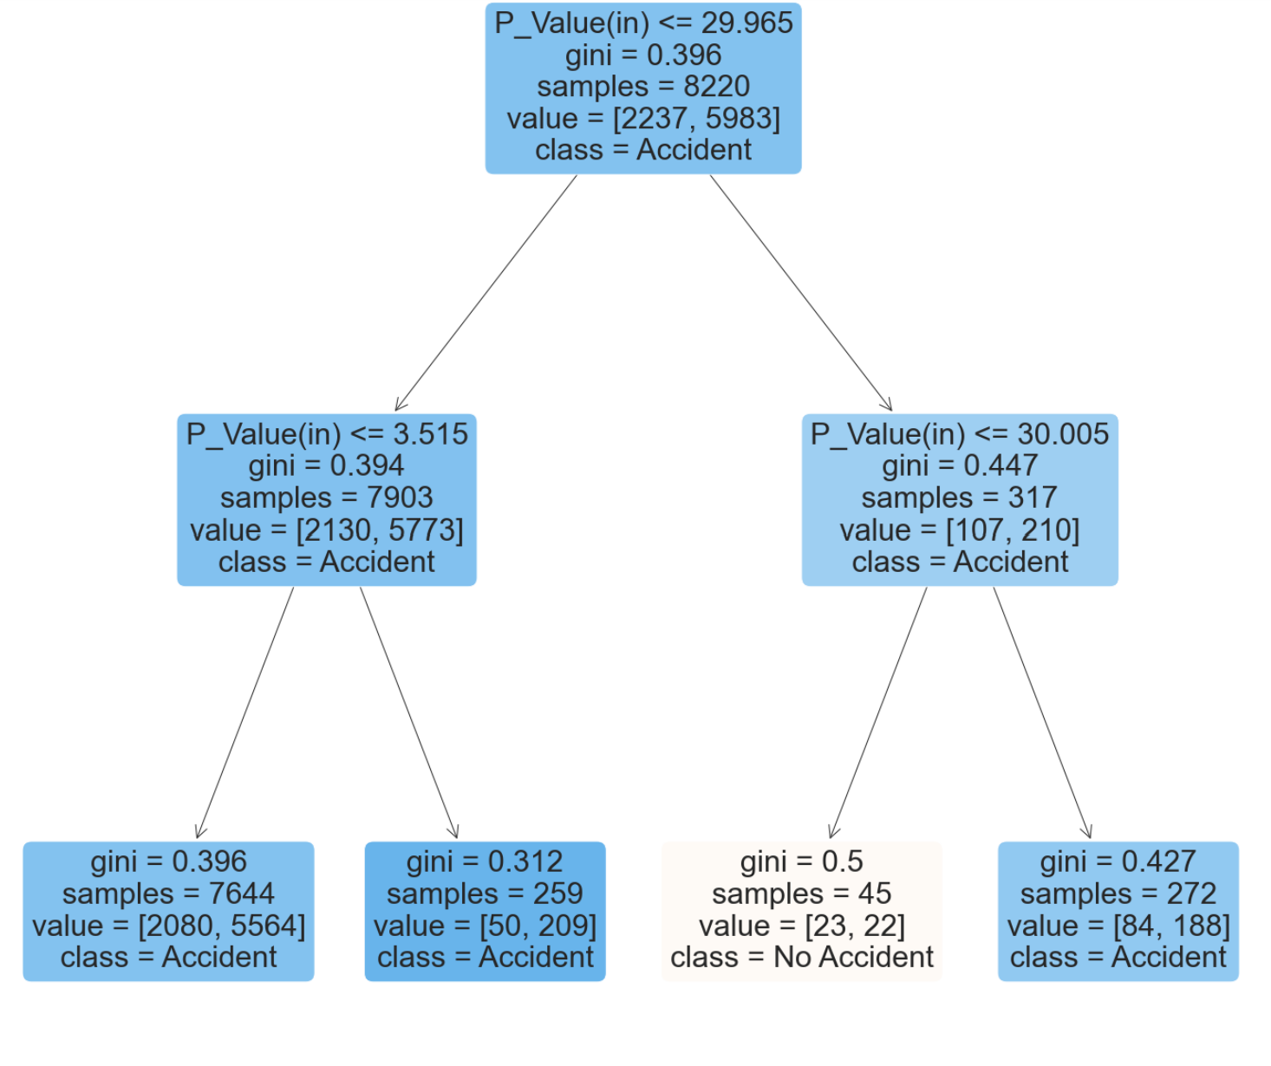
Our Prediction Model == (Can we see the future?)
Classification Tree Model
Max Depth==2
Notes:
Since 1 and 2 max depth have the same accuracy, (click)
we decided to go with a max depth of 2.

Slide 22
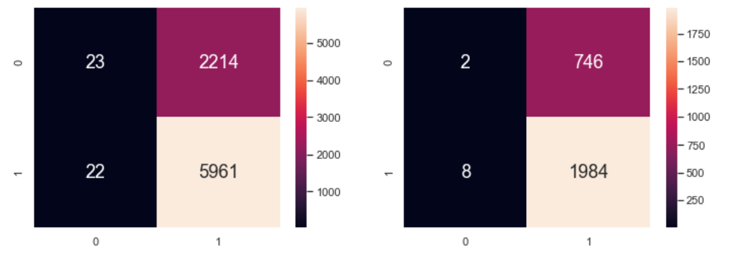
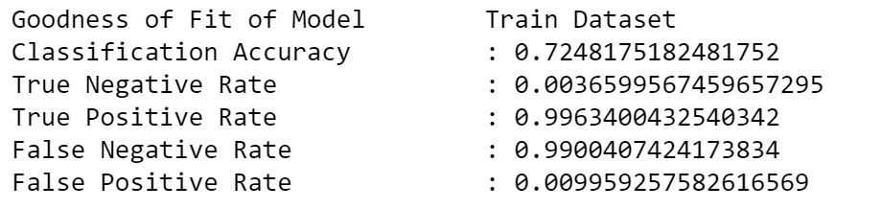
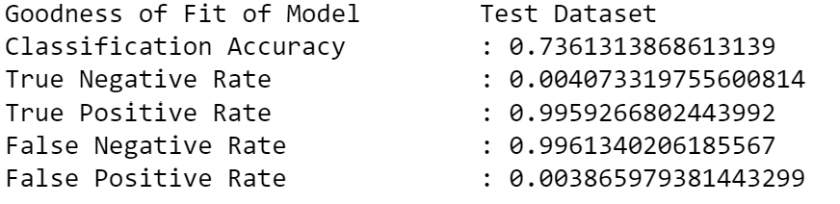
Our Prediction Model == (Can we see the future?)
Notes:
As we have observed it has a moderate accuracy of about 70%, this is not a very accurate variable for predicting traffic accidents. There is a discrepancy of accuracy of 1 to 2% between the train and test data. The classification accuracy will vary from 1 to 5 % whenever we re run the code, which is not a desirable trait for machine learning. Although, the True Positive Rate is close to 1, this prediction is not good as the False Negative Rate is also extremely close to 1.

Slide 23
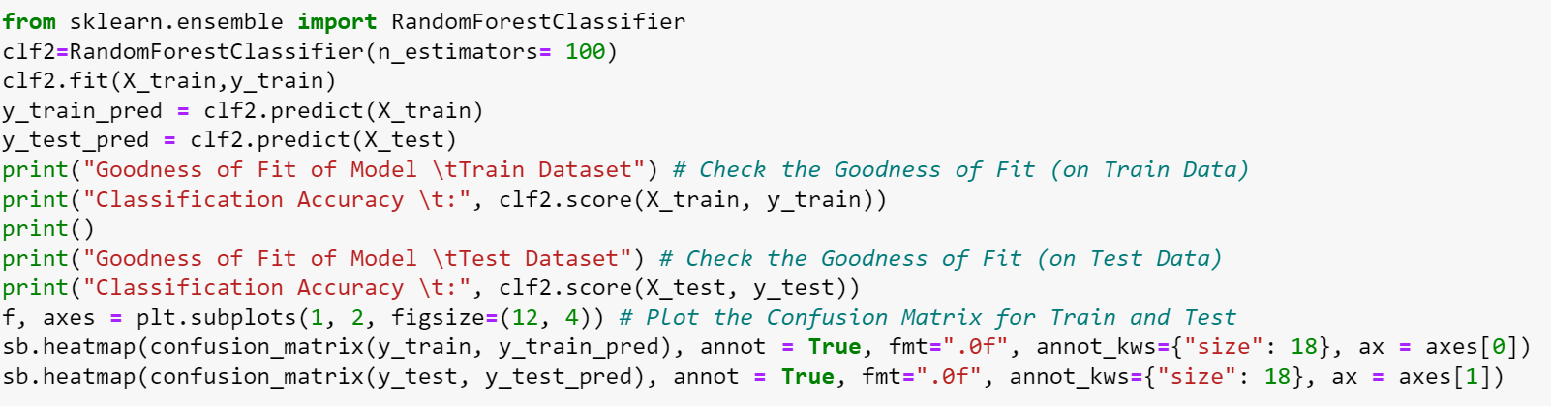
Our Prediction Model == (Can we see the future?)
Random Tree Classifier (learnt)
Notes:
Afterward, our team implemented the random forest classifier that we learnt through this process, which takes the average of all the predictions and prevents overfitting by creating trees on random subsets, in hopes of improving the classification accuracy
However, we can observe that it still has a moderate accuracy of 70% whereby the train classification accuracy increased by 2% while the test classification accuracy decreased by 1. There is also no drastic change in the classification errors and accuracy of the classifier. Hence, this is not a desirable prediction for machine learning.

Slide 24
Our Conclusion
+=
/*What we have derived*/
Notes:
So what have we derived?

Slide 25
Is there a correlation?
Notes:
The big question is… Is there a correlation between weather and traffic accidents? Following our prior hypothesis and the results of our analysis, there would seem to be a weak correlation between weather and traffic accidents, additionally the prediction may very well be inaccurate.

Slide 26
Our Results == (So what have we derived?)
Weather is not an entirely accurate model
There are too many variables affecting traffic accidents
Social factors such as crime rate may be at play
Precipitation may not be the key factor as fog does not have precipitation but affects traffic by decreasing visualisation or wind speed affecting
Notes:
This is possibly due to a single variable of weather not being sufficient to predict something as complex and multivariate as traffic accidents which have too many factors at play. Some social factors to considered such as drink driving and crime rate in a city, which cannot be easily predicted. In extreme weathers, most people might avoid driving or be more cautious when they drive. Furthermore, some weather conditions such as fog and cold weather may not be accurately represented using a measure such as precipitation, as they impact drivers in different ways.

Slide 27
Weak
Notes:
To sum it all up, the correlation between weather and traffic accidents is weak and is not a good enough model to solve a complex problem such as predicting traffic accidents.

Slide 28
Thanks!
Please keep this slide for attribution
Notes:
With that we come to the end of our presentation. Thank you for listening and have a wonderful day!

Slide 29
References == (Where we get our info from)
Datasets
https://www.kaggle.com/datasets/sobhanmoosavi/us-weather-events
https://www.kaggle.com/datasets/sobhanmoosavi/us-accidents
Photos
https://en.wikipedia.org/wiki/List_of_flags_of_the_United_States

